Slide 1
Princeton AWS Meetup
Infrastructure as Code with Terraform
Alejandro Baltra
Doug Kerwin
Phil Fugate

Slide 2
Welcome to Billtrust!
Billtrust is the pioneer of payment cycle management solutions which take the pain out of payments for our customers, and their customers. Our end-to-end payment cycle management solution automates every step of the invoice-to-cash process.
Located in Central NJ for 18 years, offices in Denver, Chicago, ...
Recent transformation to public cloud (AWS, Azure) and CI/CD
Agile, DevOps, Microservices, Automate everything

Slide 3
What we’ll be talking about today
What is Terraform and why we chose it (Doug Kerwin, Director of DevOps)
Terraform in action (Phil Fugate, Software Architect)
Terraform Providers (Alejandro Baltra, Senior Software Engineer)

Slide 4
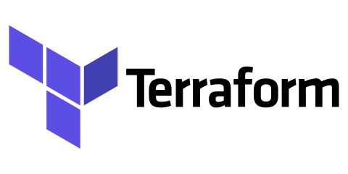
What is Terraform?
Terraform is an open source tool that allows you to declare infrastructure code to provision resources across multiple cloud and SaaS providers.

Slide 5
Terraform vs Configuration Management Tools
Chef, Puppet, Ansible, SaltStack - Configuration Management Tools
(primarily install and manage software on existing servers)
Terraform, CloudFormation - Provisioning Tools
(provision the servers and other infrastructure themselves)

Slide 6
Why use Terraform?
Creating infrastructure by hand is like writing a program, compiling it, then deleting the source code.
Infrastructure = much more than just “servers”
Configuration of cloud resources ~= Application code

Slide 7
Why we chose Terraform over CloudFormation
Terraform | CloudFormation
Supports multiple clouds and third party products | Supports only AWS
Code is proprietary HCL, reads like pseudocode, easy to use. Great documentation. | Code is yaml or json, ugly, hard to read, hard to write. Not great documentation.
Is open source and can be extended with your own custom providers | Is Amazon proprietary, can be extended by deploying your own custom Lambda functions
State managed in a file (typically stored on S3). Can import existing resources into state. Can query existing resources. | State managed by AWS. Can not import existing resources into state or query existing resources. Supports rollback, but sometimes things get stuck in Update Rollback Failed state :(

Slide 8
Terraform Example
Demo to spin up a small sample application!
Done

Slide 9

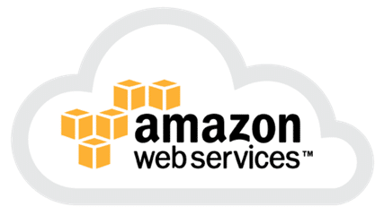
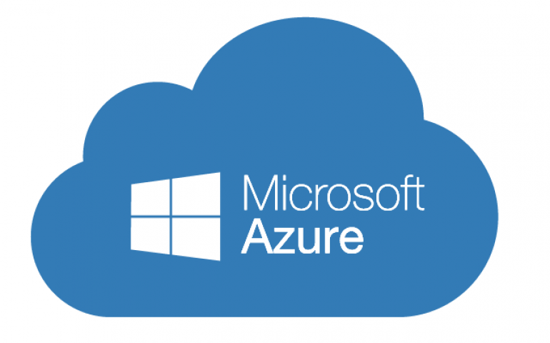
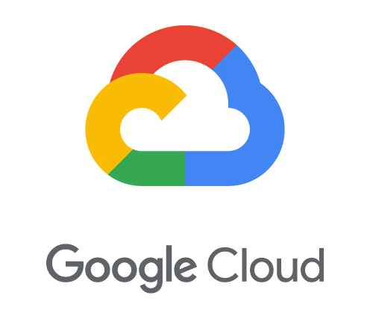


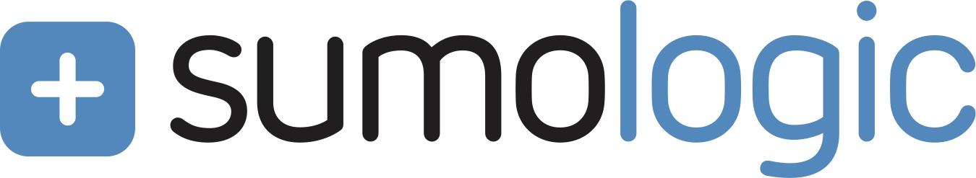
What is a Terraform Provider?
A provider is responsible for understanding API interactions and exposing resources. Providers generally are an IaaS (e.g. AWS, GCP, Microsoft Azure, OpenStack), PaaS (e.g. Heroku), or SaaS services (e.g. Terraform Enterprise, DNSimple, CloudFlare).

Slide 10
The TF State and syncing your infrastructure
TF State is a JSON representation of your infrastructure graph
Why do we need it? TF needs a way to track history changes that is flexible enough to work with several different vendors that can keep metadata and real-world references to human-named resources
Are all features of TF State necessary? No. It’s also used for optimization, since TF can use it as a cache. While TF will try to re-sync your state on every apply and plan, this might not be feasible with bigger setups or some vendors.
Is it versionable? Yes. Using remote state, you can make sure all developers are using the same version of the state and let Terraform handle remote locking to avoid conflicts.

Slide 11
The TF State and syncing your infrastructure
A demo TF State file can be found here:
https://github.com/billtrust/meetup-terraform-provider/blob/master/server/terraform/terraform.tfstate

Slide 12
When should I create a provider?
Rule of Thumb
If it’s required for the platform to run, it should probably be in Terraform

Slide 13
Creating custom Providers
While they can be written in any language, the recommended one is Go
Official documentation is not bad, not great either
In-depth Go knowledge is not really necessary
They are mediators between Terraform defined infrastructure and the API that supports it
Best source of examples is the source code of existing providers (see appendix)

Slide 14
Creating custom Providers
What will you need to implement?
main.go, which is your entrypoint to the provider
provider.go, where you will setup global configurations for your client and consume variables passed in the initialization of your provider in Terraform. Will also contain entries for all resources this provider can handle.
resource_<resource-name>.go contains the logic to manage this particular resource. It requires 4 methods to be implemented to handle each of the CRUD operations.
resource_<resource-name>_test.go is optional and it will contain unit tests for our resource file

Slide 15
Creating custom providers
Let’s look at some code...

Slide 16
Creating custom Providers
Some tips picked up along the way:
Make sure you return nil in the READ function when we get an error from the service, otherwise TF won’t try to recreate the resources
For creating the Go HTTP Client, there are tools that can generate the code for you, such as GoSwagger
All variables saved in the state can be referenced in other resources through TF’s interpolation mechanism
Datadog’s official provider is open source and has some very readable code.
TF 0.12 was released not too long ago. That has some changes to the syntax that will require updates to the providers

Slide 17
Q & A

Slide 18
Appendix
Terraform.io (https://www.terraform.io)
Go (https://golang.org/)
Datadog’s TF Provider (https://github.com/terraform-providers/terraform-provider-datadog)
Terratest (https://github.com/gruntwork-io/terratest)
All source code shown for this presentation and instructions on how to compile/use it can be found in Billtrust’s Github repository https://github.com/billtrust/meetup-terraform-provider

